Slide 1
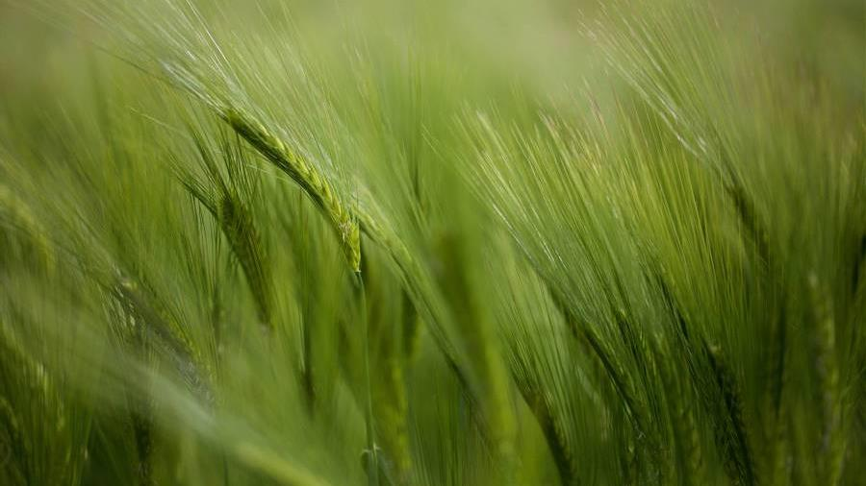
The kingdom of God

Slide 2
Matthew 3:2
Matthew 3:2
Matthew 4:17
2 “Repent, for the kingdom of heaven has come near.
17 From that time Jesus began to proclaim, “Repent, for the kingdom of heaven has come near.”
Matthew 4:17
This message about the Kingdom of God is found in all 4 gospels

Slide 3
Repent
Metanoia
Shuv
Meta = Change
Noia = Mind
Literally means to change your mind.
Turn back to God

Slide 4
What is the Kingdom of God
Vasíleio or basileia
Utopic or Utopian society
Speaks to
Authentic
Can mean rule or region.
Can mean God’s realm
God’s activity
God’s rule
God’s power
God’s reach
Not a dualistic experience.
It is the ideal existence for humanity.
Designed with the help and input of agricultural experts in the field

